Slide 1
Data Analytics Lifecycle (Big Data)
Dr. Rajendra B. Patil
The notes are based on the Reference Book:Big Data and Analytics, Wiley

Slide 2
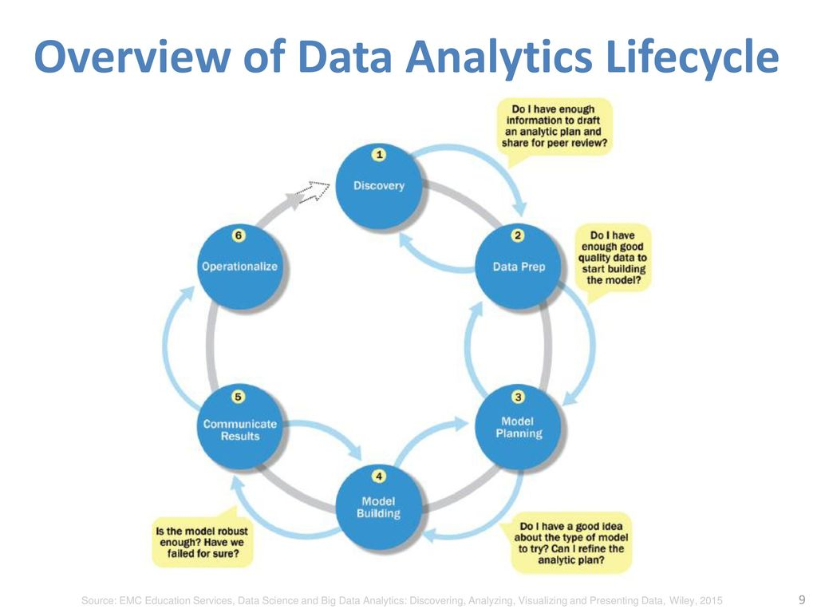

Slide 3
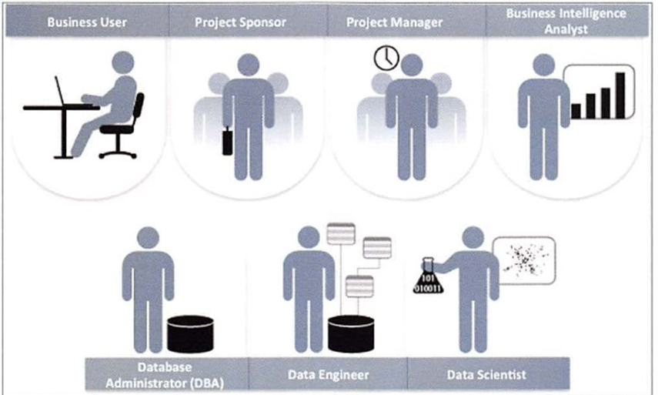
Key Roles for a Successful Analytics Project
In October 2012, Harvard Business Review featured an article titled "Data Scientist: The Sexiest Job of the 21st Century",
DJ Patil and Tom Davenport described the new role data scientists.

Slide 4
Key Roles for a Successful Analytics Project
Business User: Someone who understands the domain area and usually benefits from the results.
Project Sponsor: provides the funding
Project Manager: Ensures key milestones and objectives are met on time
Business Intelligence Analyst: Provides business domain expertise
Database Administrator (DBA): configures the database environment to support the analytics
Data Engineer: Leverages deep technical skills to assist with tuning SQL queries
Data Scientist: Provides expertise for analytical techniques, data modeling, and applying valid analytical techniques to given business problems

Slide 5
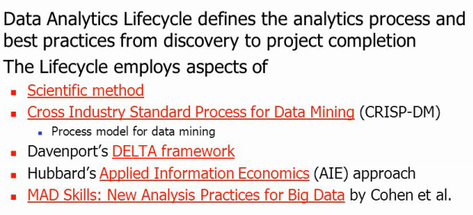
Background & Overview : Data Analytics Lifecycle

Slide 7
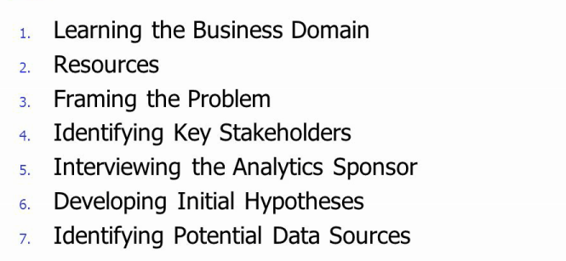
Phase 1: Discovery

Slide 8
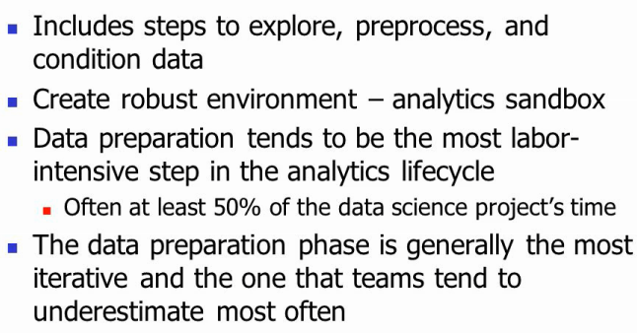
Phase 2: Data Preparation

Slide 9
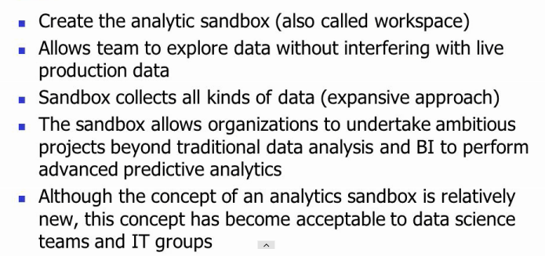
Preparing The Analytics Sandbox

Slide 10
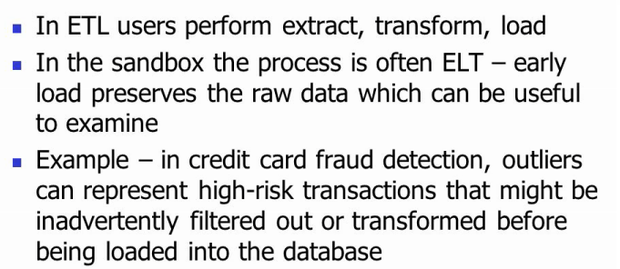
ETL-T

Slide 11
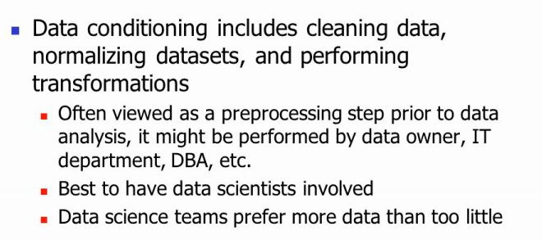
Data Conditioning

Slide 12
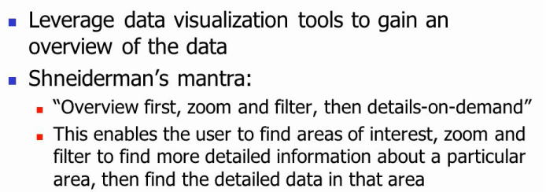
Survey and Visualize

Slide 13
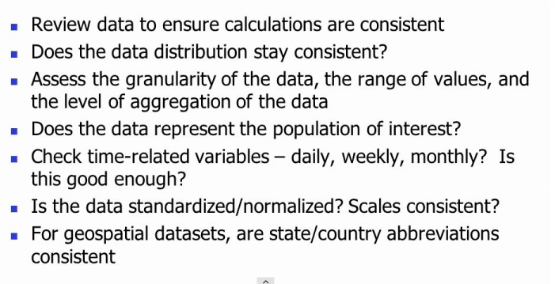
Survey and Visualize

Slide 14
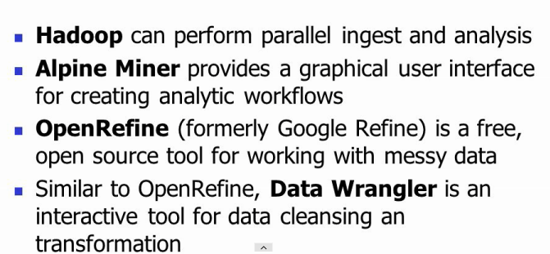
Common Tools for Data Preparation

Slide 15
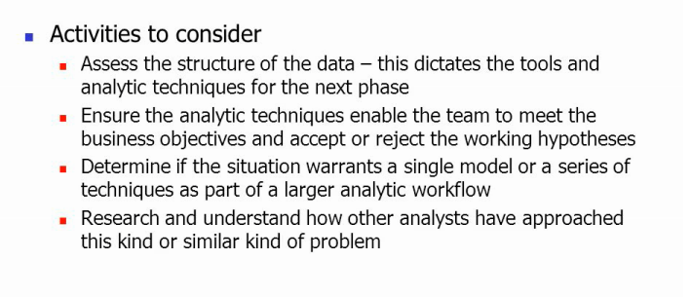
Phase 3:Model Planning

Slide 16
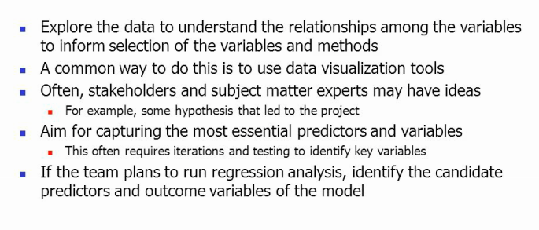
Data Exploration

Slide 17
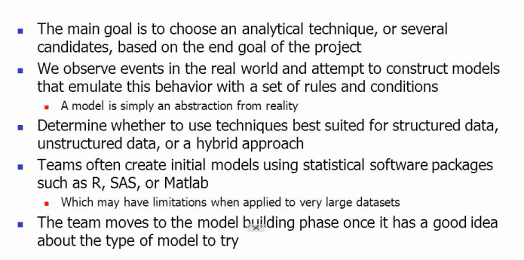
Model Selection

Slide 18
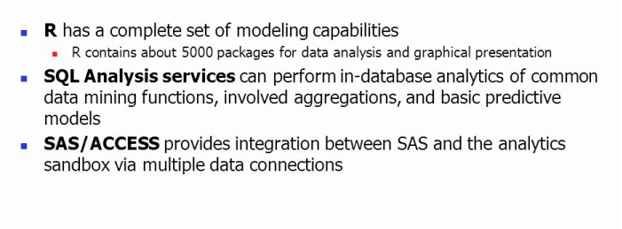
Common Tools

Slide 19
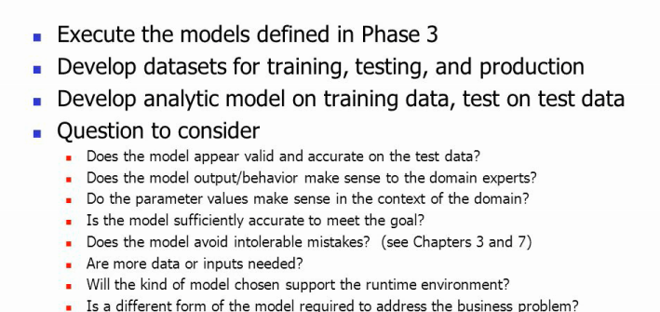
Phase 4: Model Building

Slide 20
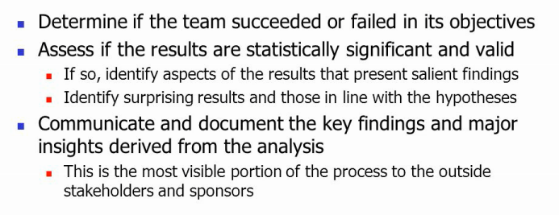
Phase 5: Communicate Result

Slide 21
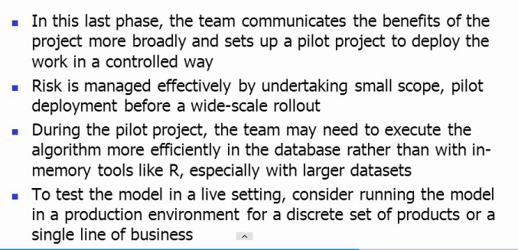
Phase 6:Operationalize

Slide 22
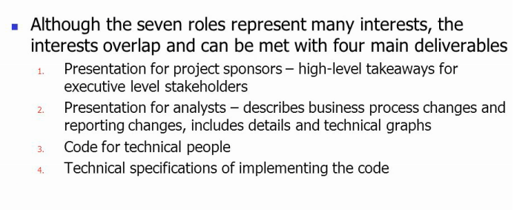
Operationalize

Slide 23
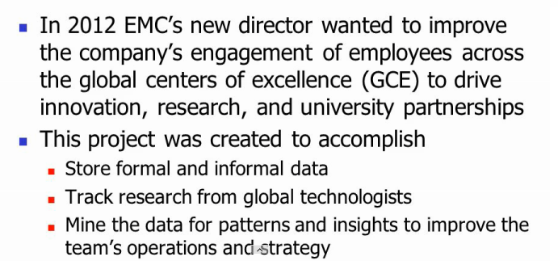
Phase 8: Global Innovation Network and Analysis

Slide 24
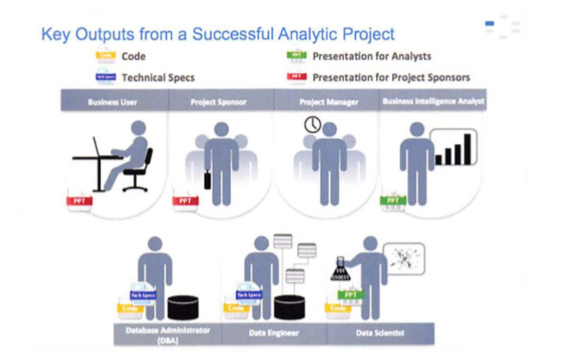

Slide 25
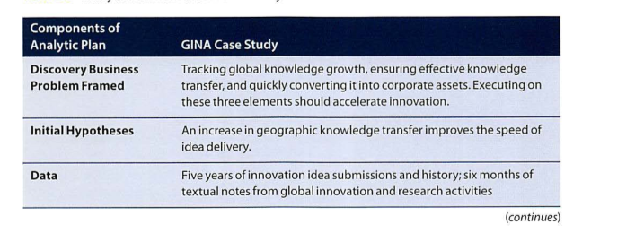
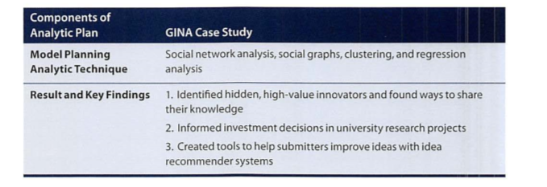
Phase 8: Global Innovation Network and Analysis

Slide 26
Review and QA

